Slide 1
Variable Dienstleistungsentgelte
eine faire Lösung für Betreiber und Direktvermarkter ?
Notes:
Vorstellung Team

Slide 2


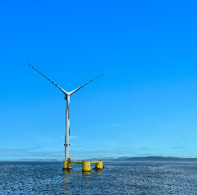
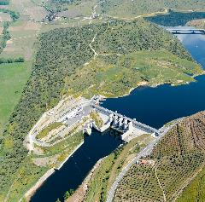
ENGIE Activities in EUROPE
4 main renewable
technologies in Europe
Solar
1.8 GW
Offshore wind
1.5 GW
SOLAR
ONSHORE
WIND
15.6 GW
@100 %
Hydro
5.8 GW
Onshore wind
6.5 GW
  Present in key markets for
  renewable growth
OFFSHORE
WIND
HYDRO

Slide 3
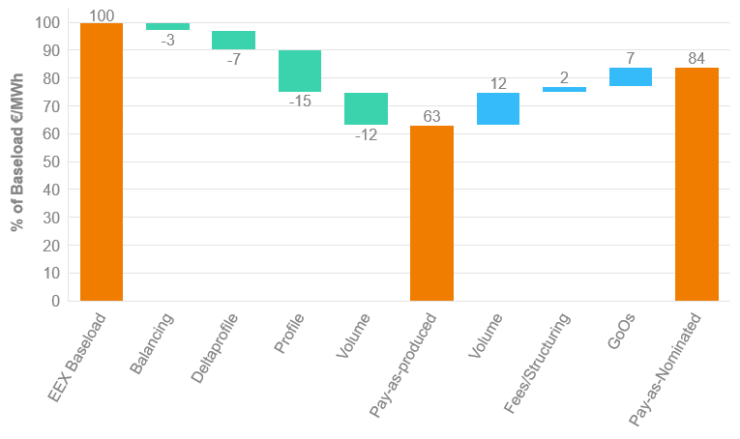
UNDERSTANDING THE ELEMENTS OF PRICE FINDING*
Baseload forward price
Market prices for (future) baseload power
Power prices are highly volatile
Profile risk
Difference between average day ahead spot prices and prices that were achieved during each hour of production
Degree depends on power market dynamics
Volume risk
Accounting for intermittency of production
Balancing cost
Cost to account for difference between forecasted and actual production
Fees/Structuring
Cover costs for risk taking and structuring of PPA power products for end consumer
*Exemplary indicative pricing for a German RES asset; actual pricing will be individual for each individual asset, contract structure and tenure and will fluctuate according to market conditions

Slide 4
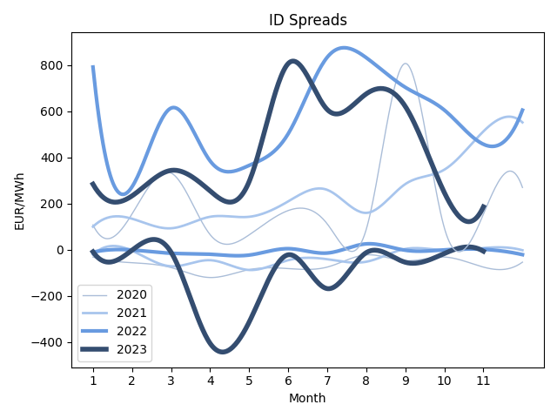
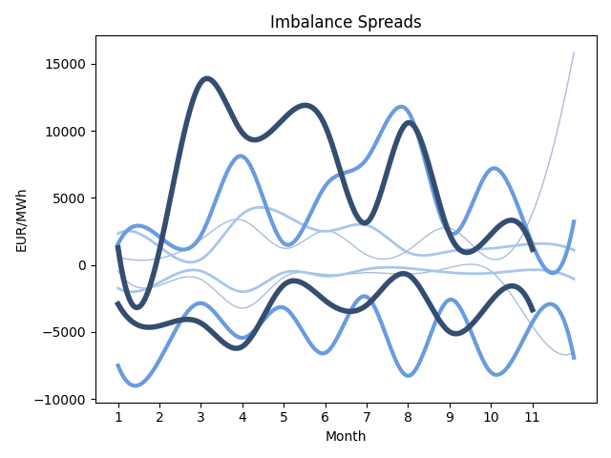
Market Overview I

Slide 5
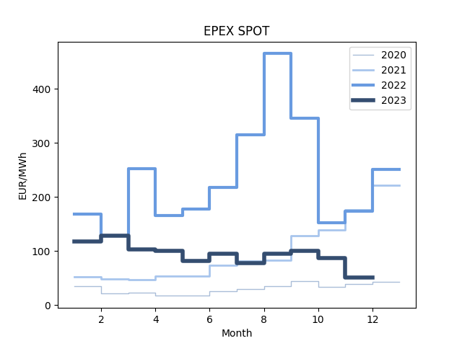
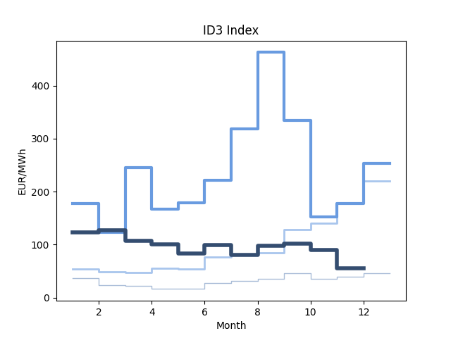
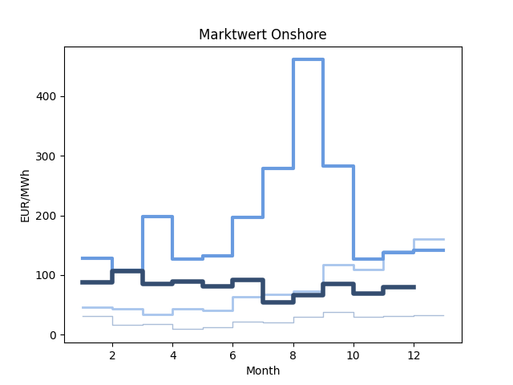
Market Overview II

Slide 6


SPRECHEN SIE UNS AN!
Philip MEISSNER
Philip.Meissner@engie.com
+ 49 (0) 221 46 90 50 64

