Slide 1


Effizienzsteigerung und Lebensdauerverlängerung von Getrieben
und Lagern
Stefan Bill​
Managing Director​
REWITEC GmbH
Dr.-Hans-Wilhelmi-Weg 1
35633 Lahnau
Germany​

Slide 2
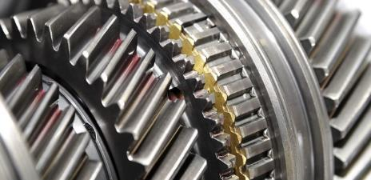
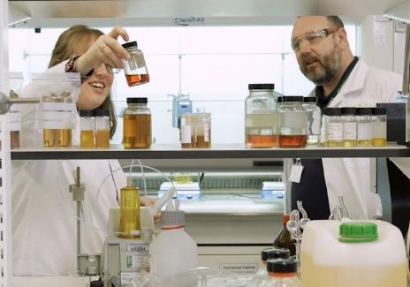

REWITEC GmbH
Founded in 2003
Part of Cargill since July 2022
Manufacturer of
Phyllosilicate additive technology
Close cooperation with research institutes and universities
Patents in Europe, China and US

Slide 3


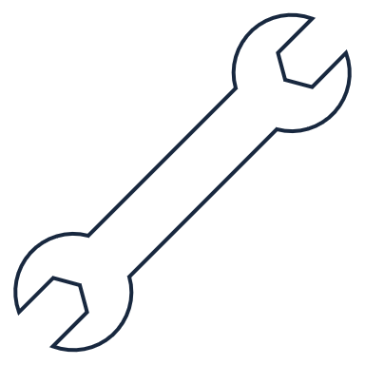

The challenges of unscheduled maintenance costs
Design flaws, environmental conditions, missing or even wrong maintenance can cause unforeseen breakdowns:
Maintenance represents 25% of the total wind turbine cost over its lifetime
Unscheduled maintenance represents
30 - 60 % of total maintenance costs
Up to 14 days needed to repair a gearbox or bearing - more than any other component
Average cost to repair a gearbox failure is
$380,000

Slide 4
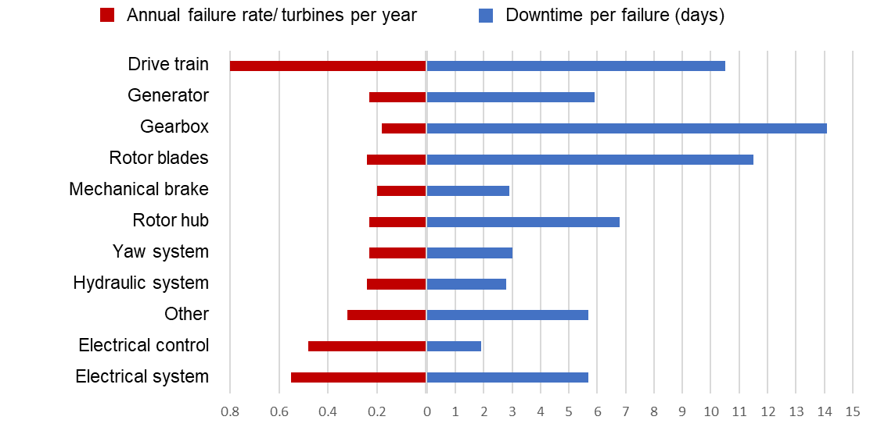
Wind turbine reliability remains an issue
(%)

Slide 5
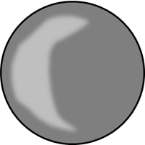
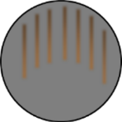
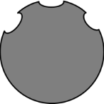
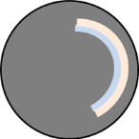
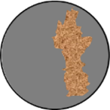
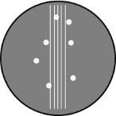
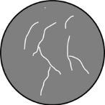
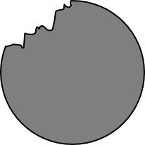
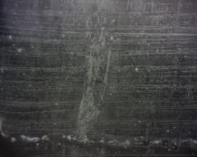
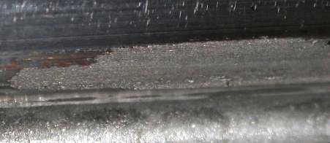
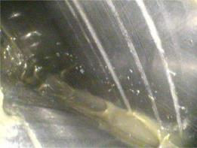
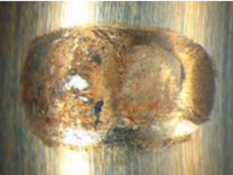
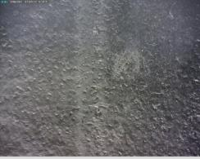
Typical damage to wind turbine gears & bearings
Micropitting/ grey staining
Fretting corrosion
False brinelling
Smearing and scuffing
Electric
damage
White etching areas/ cracks
Macropitting
Chemical corrosion

Slide 6
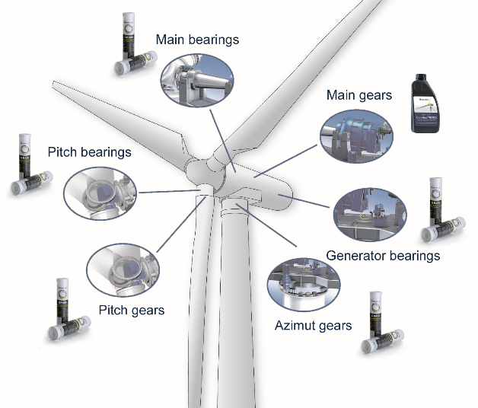



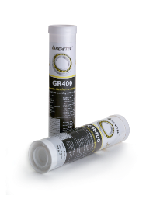
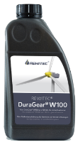
Application in wind turbines
Surface damage can be costly, the technology can prevent, repair and protect them
  More than 3,000 successfully treated wind turbines globally
Gears
Bearings

Slide 7
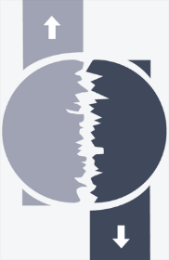
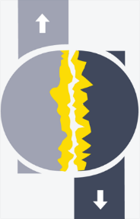
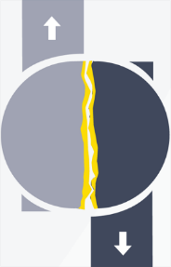
How does it work?
Step 1
Step 2
Step 3
Significant reduction of friction, wear, roughness and temperature
Advantages:
Compatibility to all common lubricants
Temperature independent
No chemical interactions with other lubricant parts
Low dosage

Slide 8


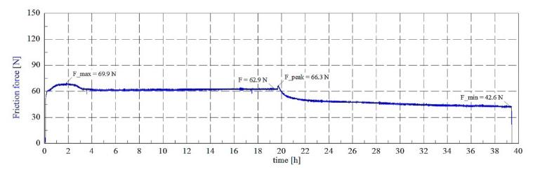
Scientific test
2-Disc assembly rolling wear test – gear oils
Reduction in friction
Oil | Friction reduction | Roughness reduction
Castrol Optigear Synthetic X320 | 33 % | 41 %
Mobilgear SHC XMP 320 | 35 % | 44 %
Klübersynth GEM 4-320N | 40 % | 54 %
Fuchs Unisyn CLP 320 | 36 % | 50 %
Amsoil PTN 320 | 46 % | 18 %
Shell Omala S4 GX 320 | 42 % | 25 %
Klüberbio EG 2-150 | 55 % | 40 %
Fuchs Pentosin EG FFL-7A | 41 % | 35 %
Automotive racing gear oil | 55 % | 40 %
Stress value: 1 GPa (normal force 2150 N)
Rotating speed: 424 rpm / 339 rpm, slip 20 %
Test-duration: 39,3 h
Temperature: oil inlet temperature 60 °C
Friction coefficient: µ=normal force/friction force
REWITEC® application
Castrol Optigear Synthetic X320

Slide 9
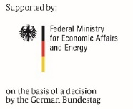
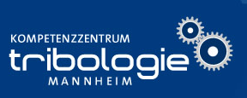
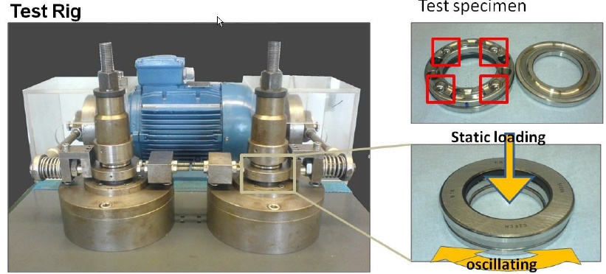
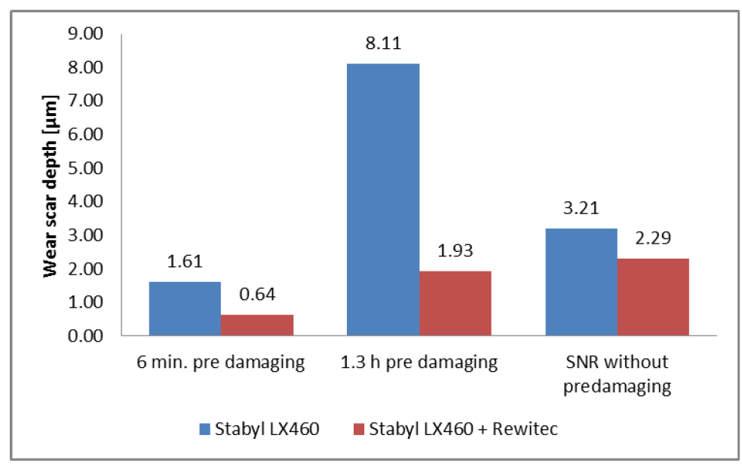
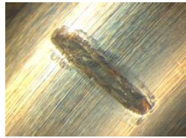
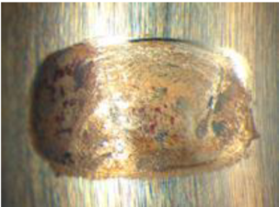
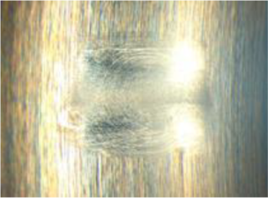
False-Brinelling test – ​
For pitch bearing evaluation​
9
Frequency: 25 Hz
Oszillation angle: +/- 0.5° -> +/- 3.0°
Axial load: 3 kN to 4 balls (750 N per ball)
Temperature: room temperature
Test bearing: ARKL Type 51206 with 4 rolling elements
Fuchs LX460
Fuchs LX460
Fuchs LX460 + REWITEC™
pre-damaging
(1.3 h; +/- 0.5°)
Run after the damaging
(3 h; +/- 3°)

Slide 10


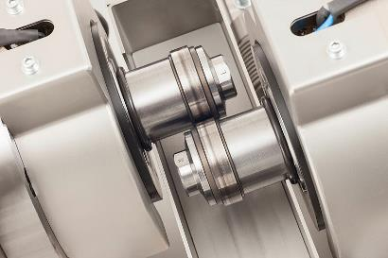
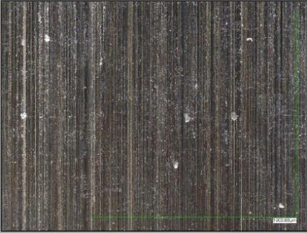
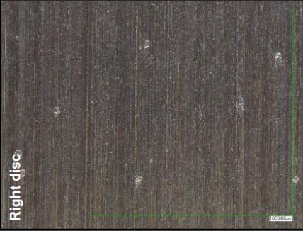
Surface repair (short test)
Blank disk
Gear oil + Phyllosilicate
2-Disk surface roughness:
Ra reduced by 34 %
Rz reduced by 40 %
Ra = 0.30 µm
Rz = 2.70 µm
Ra = 0.20 µm
Rz = 1.62 µm
Notes:
WT gear oil 320 + 0.2 % phyllosilicate
X 200 magnification
Sample weight loss (right disc) = 0.0013 g

Slide 11
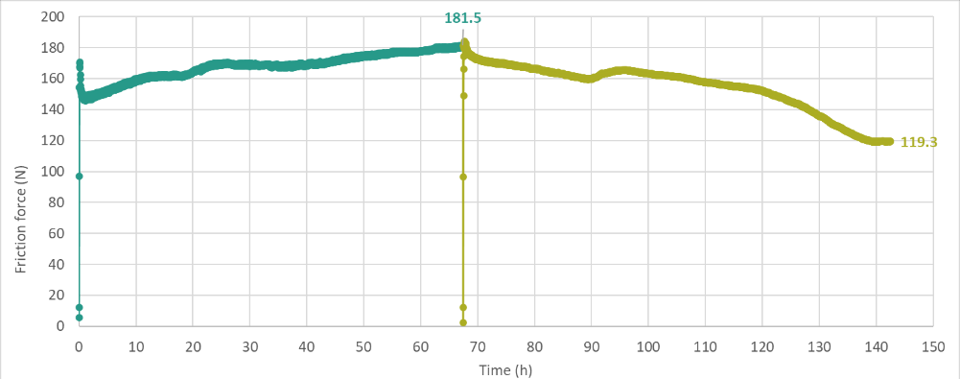
Friction reduction (endurance test)
0.2 % Phyllosilicate addition
Disk wear phase
Disk repair phase
Cargill 2-disk test rig endurance test
ISO VG 320 industrial gear oil
Load: 2190 N
The Phyllosilicate technology gave a 62 N (34 %) reduction in friction force
Rotating speed: 424 rpm / 339 rpm, slip 20 %
Oil temperature: RT °C
Notes:
Why is friction force so much higher than Mannheim? RT vs 60 C oil? More viscous
Waiting on surface roughness results – can’t share them today

Slide 12
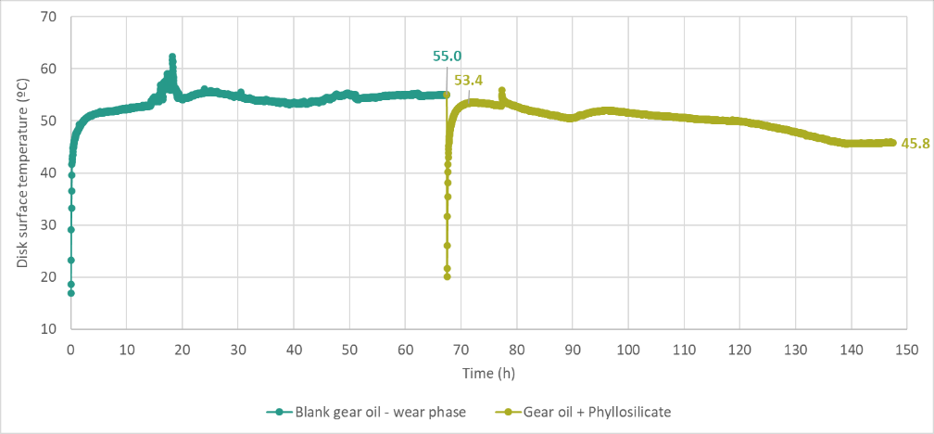
Temperature reduction (endurance test)
0.2 % Phyllosilicate addition
Disk wear phase
Disk repair phase
Cargill 2-disk test rig endurance test
ISO VG 320 industrial gear oil, Load: 2190 N, Rotating speed: 424 rpm / 339 rpm, slip 20 %
The phyllosilicate technology reduced the disk surface temperature by ~8 °C, mimicking the friction trends

Slide 13
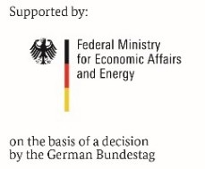
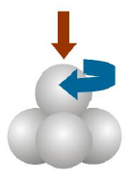
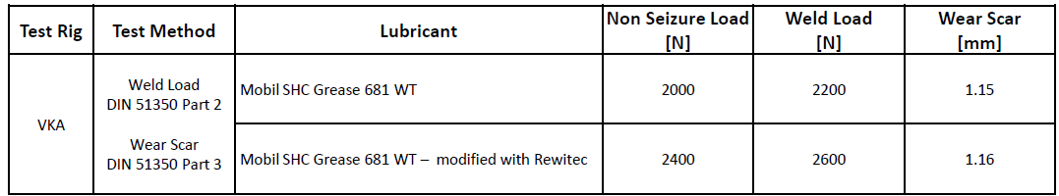
4 Ball test bench – grease test
According to DIN 51350 part 2 ( welding force ) / 3 ( wear test):
Test load: 2000 – 12000 N / 300 N
Rotating speed: 1450 rpm
Test-duration: 1 min / 60 min
Wind turbine grease
Wind turbine grease + Rewitec
Advantages with REWITEC:
  17 % higher non seizure load
  15 % higher weld load

Slide 14
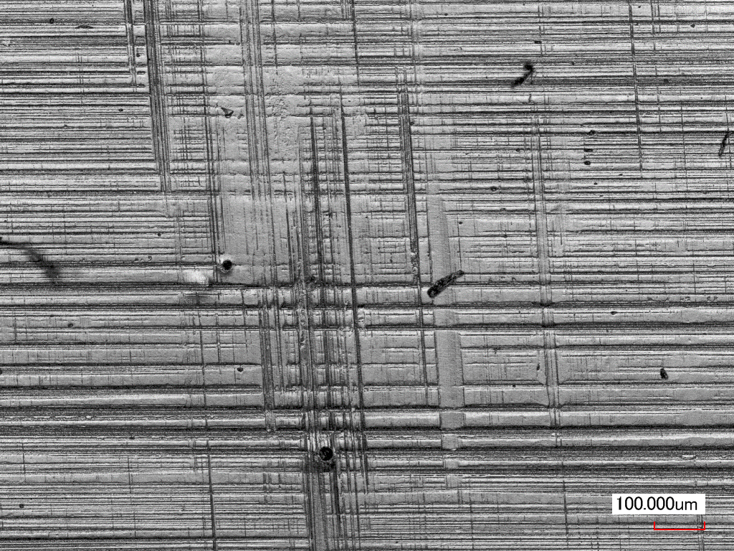
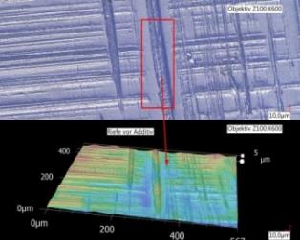
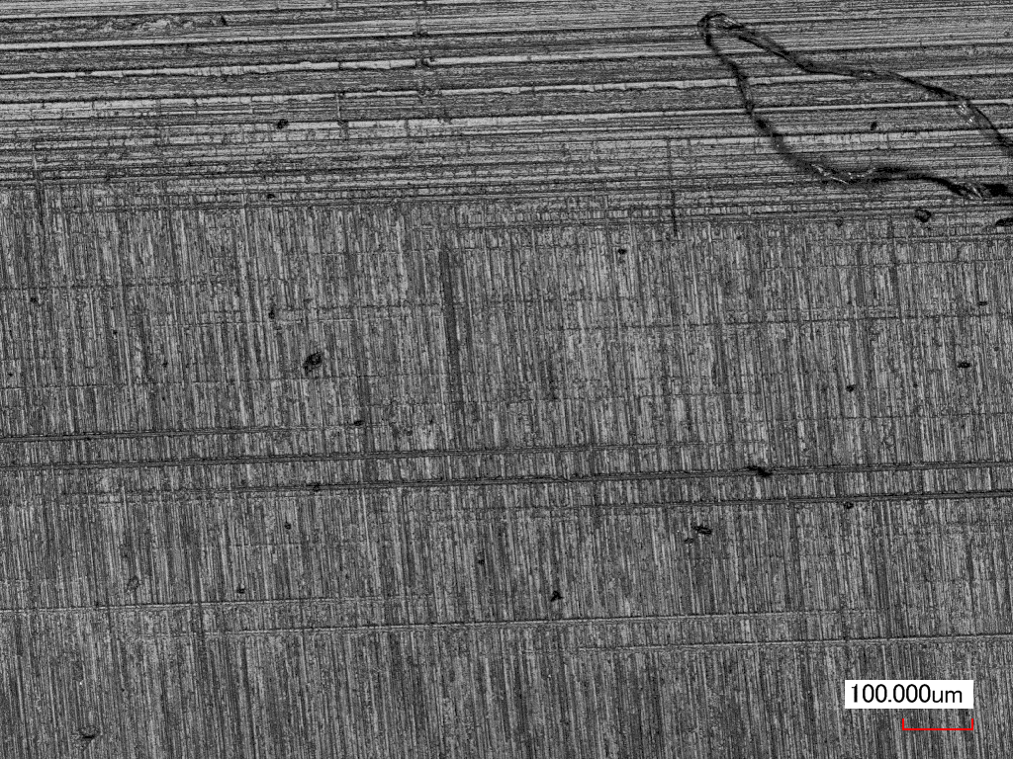
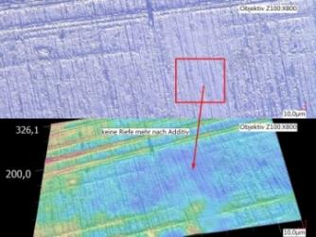
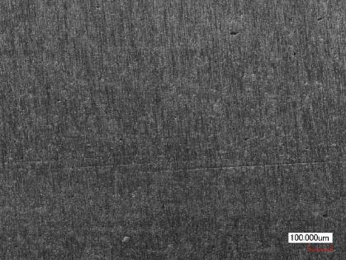
Example of application
Wear development on a Bosch Rexroth gear tooth (GE 1.5 SL) over a period of two years
07.10.2014
06.11.2014
Run through marks on the tooth flank after 6 weeks and 2 years:
  Reduction of the surface roughness and friction force
  Improved load carrying capacity
  Less stress for the tooth flank
19.10.2016

Slide 15
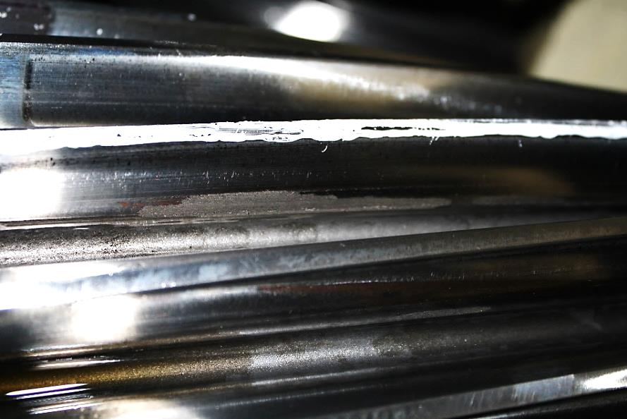
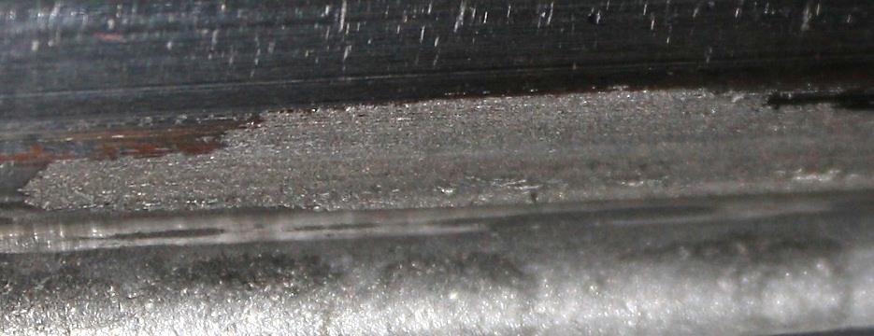
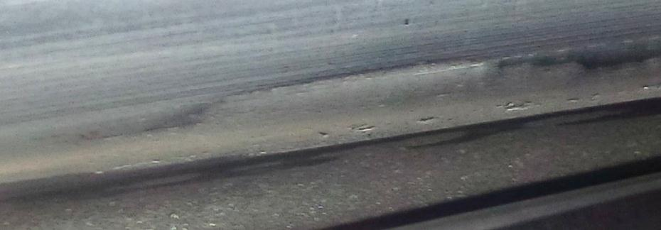
Example of a gearbox application
Gearbox CSIC 2 MW VSCF
before
Significant operational wear visible
In the foot area visible micro pitting
Oxidation visible
before
Operational wear noticeable reduced
Reduction of micro pitting
The contact pattern is optimized
after
15

Slide 16
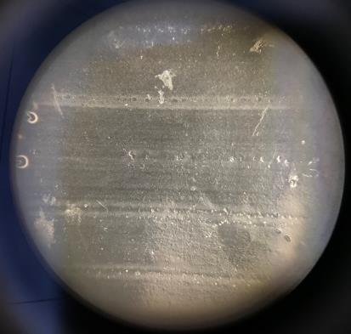
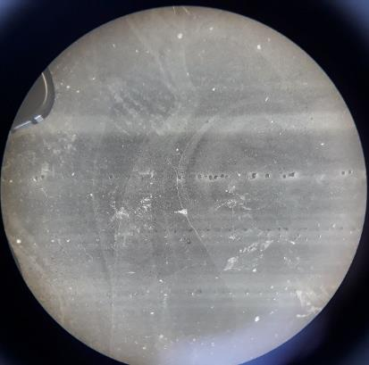
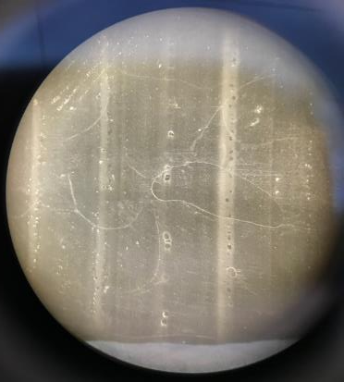
Coating and analysis of a GE 1.5 MW wind turbine main bearing (outer ring)
Picture: Before wind turbine was treated
Picture: 5 months after wind turbine was treated with additive
Picture: 12 months after wind turbine was treated with additive
Red arrow shows the same right track on the surface imprint

Slide 17



Coating and analysis of a GE 1.5 MW wind turbine main bearing (outer ring)
Picture: Before wind turbine was
treated
Ra = 0,556 µm (within the track)
Picture: 5 months after wind turbine was treated with additive
Ra = 0,403 µm (within the track)
Picture: 12 months after wind turbine was treated with additive
Ra = 0,225 µm (within the track)
Red arrow shows the same right track on the surface imprint

Slide 18






Main bearing (outer race) on GE 1.5 MW wind turbine
Before wind turbine was treated with additive
6 months after wind turbine was treated with additive

Slide 19

Wind turbine 1.5 MW
GE 1.5 SLE Planet Bearing

Slide 20



Calculated life extension of upto 17 years
  Significant reduction in the probability of failure of a main bearing post application
The earlier the application, the greater the lifetime extension

Slide 21



Our services
Technical consulting, up-tower inspections
Component surface imprinting
Component damage analysis and reporting

Slide 22

Conclusion
Less surface roughness, friction and temperature in the drive train system means:
  Less stress and wear for gearboxes and bearings
  Less stress and longer life for the lubricants
  Repairing and protection effect
  Higher efficiency
  Higher reliability and availability, no downtime
  Significant lifetime improvement
  Cost savings, higher earnings

Slide 23

Recommendations, partners and customers

Slide 24
Do you need more information?
Please do not hesitate to contact us.
REWITEC GmbH
Dr.-Hans-Wilhelmi-Weg 1
35633 Lahnau
Germany
Tel.: +49 6441 445990​
info@rewitec.com
www.rewitec.com

